Slide 1

Battle of the Neighborhoods Applied Data Science Capstone by IBM Exploring Downtown Eateries in Boston

Slide 2
Exploring Downtown Eateries in Boston
Boston’s downtown is extremely busy during the day as hundreds of thousands of office workers and tourists descend on the area. Though many of Boston's swankiest restaurants are located Downtown, budget restaurants tend to be geared towards the horde of office workers.
Having spent around 8 months working in the Financial District aka Boston Downtown, I decided to explore the nearby restaurants to tackle the everyday problem of deciding a place to eat lunch at.
This project can be used by people working in the Financial District, Boston; specially the students who are interning or recent graduates who don’t tend to cook and bring lunches to work-place and have to reply on nearby restaurants for lunch.

Slide 3
Data
Files containing Zip codes, Neighborhoods and coordinates were downloaded from - https://public.opendatasoft.com/ - https://simplemaps.com/
Processed both the files using Microsoft Excel, cleaned and filtered as well. Merged the data using VLOOKUP to create a single file containing necessary information.
This file was exported to a dataframe which then utilized Foursquare API to fetch nearby venues and the restaurant details.

Slide 4
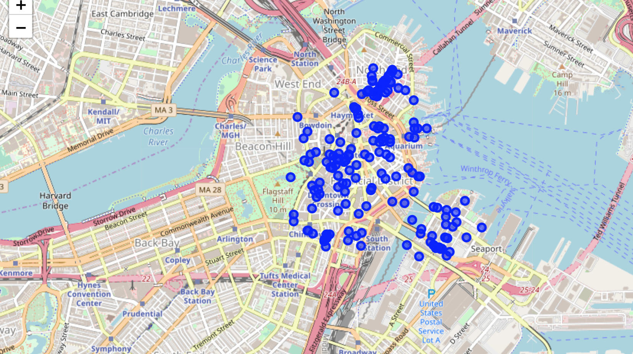
Geo-Analysis
Utilized Folium maps to visualize geographic data on maps.
Here, all the venues serving food have been plotted on a map to get a general sense of locations and density.

Slide 5
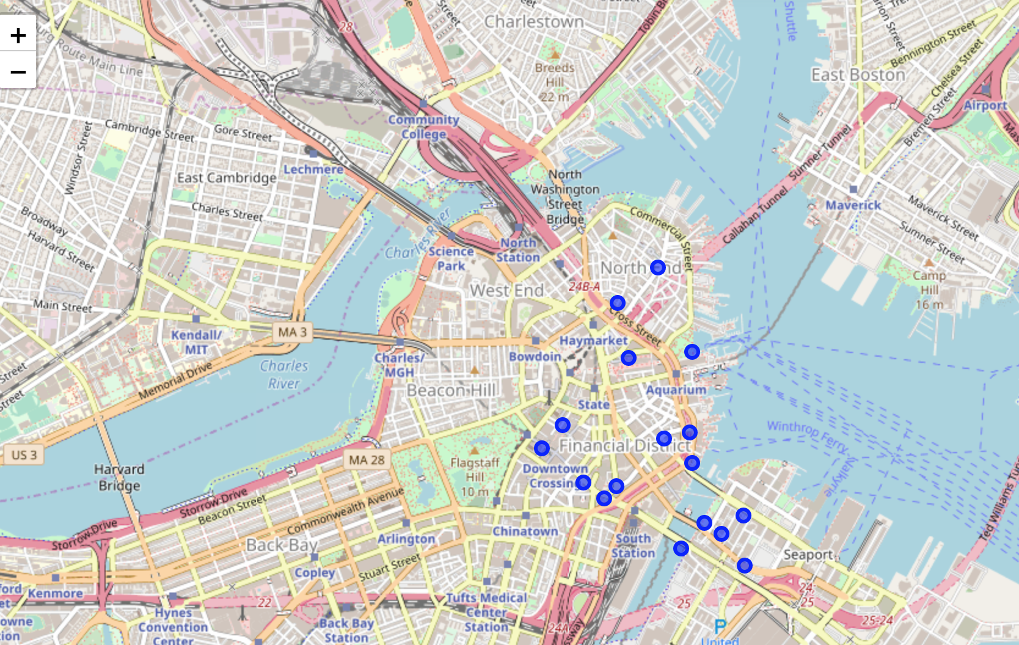
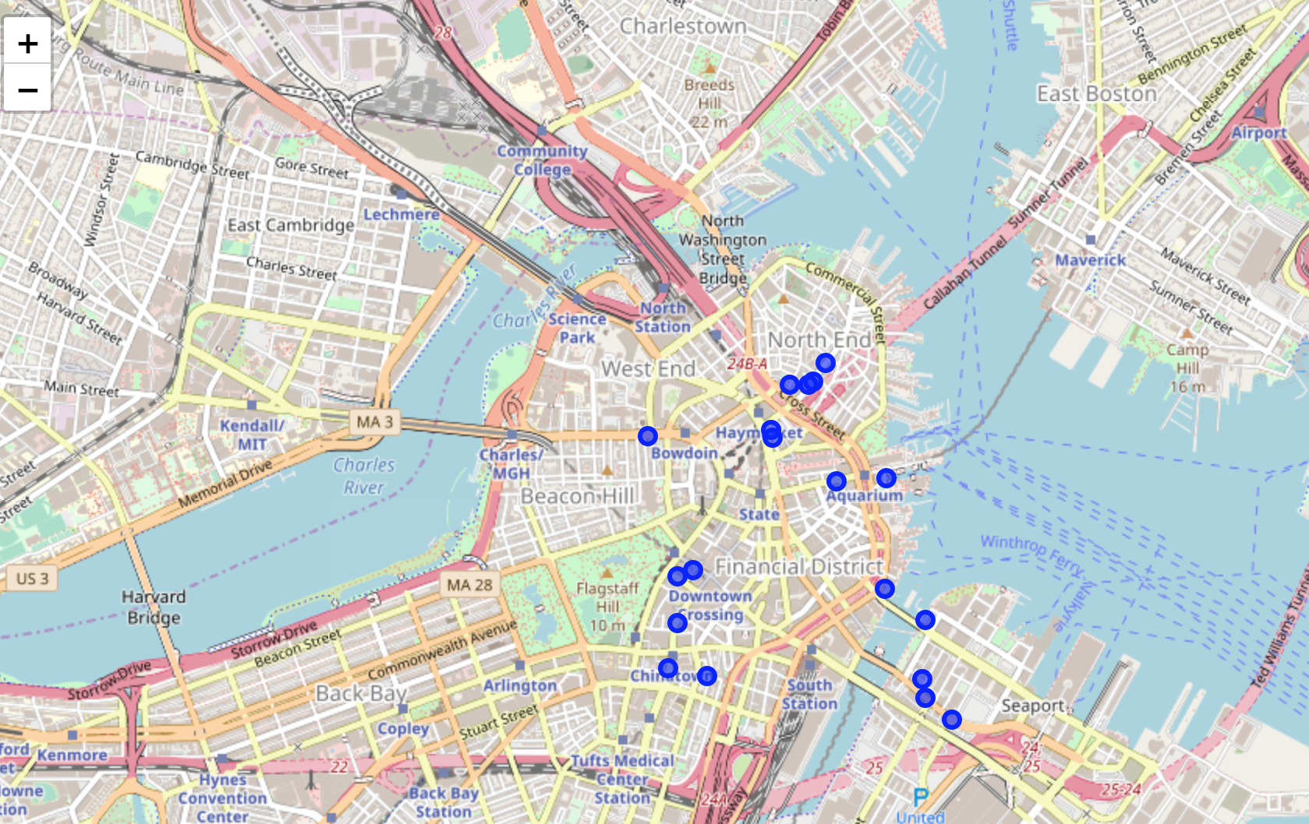
Geo-analysis(contd.)
In the map below, we can see that highly rated restaurants are evenly spread out throughout the downtown. So if you are hungry, you can get one of the best foods in the city within a 10 mins walk!
From the map below of most fav restaurants, we can see that the top liked places are mostly either in the northern half of the downtown i.e. near North End or near Chinatown and Seaport.

Slide 6
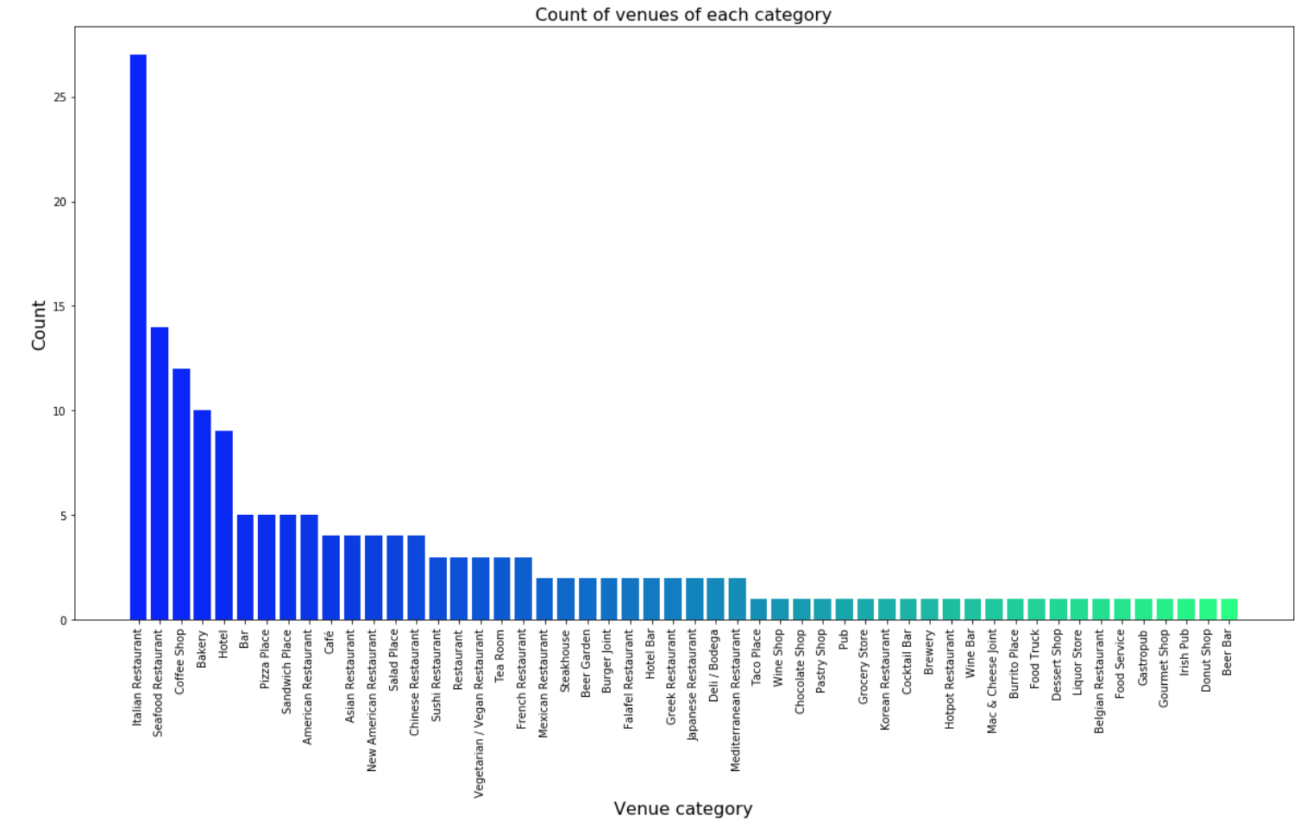
about 170 food serving venues around financial district
All the restaurants in the neighborhood have an average Rating of 8.4
More than 20 different cuisines are available
Italian Cuisine is the most popular with 27 restaurants
The lowest rating for any restaurant is 8.0 while the highest is 9.4

Slide 7
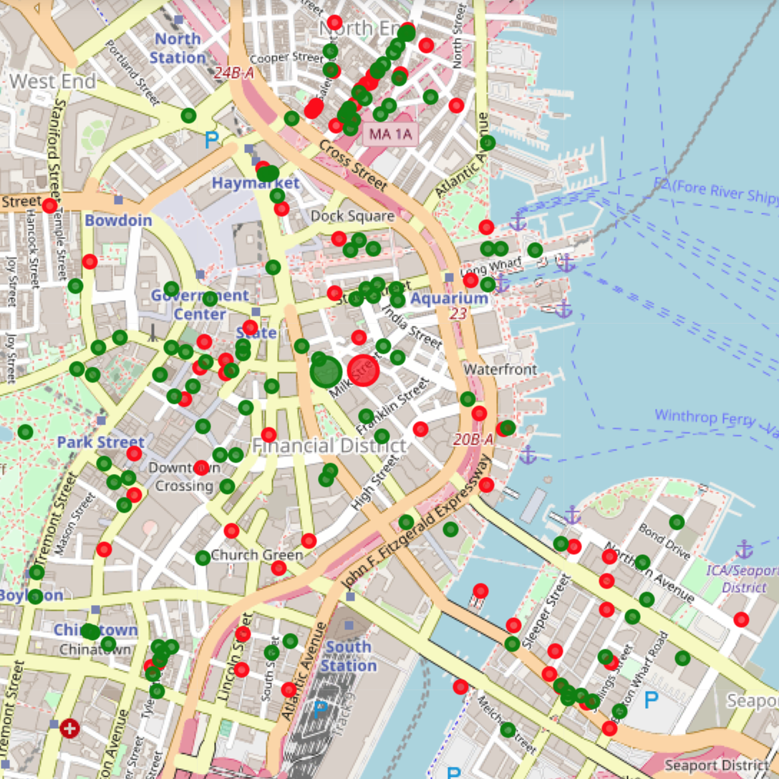
Clustering
Restaurants were clustered on basis of their location and rating.
Green is the bigger cluster with 110 restaurants. Their average rating is 8.2 though, which is quiet low when compared to the other cluster. This cluster might contain restaurants with very average food. One can also find some cheap restaurants too if lucky.
Cluster Red has an average rating of 8.8. Even though the count of restaurants is small, this cluster has the best restaurants in the area with an average of 181 likes. Be careful though, these restaurants can be expensive as well.

Slide 8
Thank you.

